Slide 1

Git
&
GitHub
Presentation by:
Samundra Acharya

Slide 2


Git
o1.
It is a version Control system
o2.
Allows to track changes to the files
o3.
Allows to collaborate with others
o4.
It is used to manage the history of the code.
o5.
Used to merge changes from different collaborators

Slide 3

Git & GitHub
What is it ?
Are they same ?
Yes!, They are different

Slide 4
Git
It is a version control system. Used to track changes in the file.
It is open-source Software.
It is available for all the major OS
It can be downloaded from Git website

Slide 5
GitHub
Git is a version control system. Used to track changes in the file.
It allows to store and share code
it can be accessed from GitHub website.

Slide 6

git --version
Check Git Version
This command will display the version of git installed on your system.

Slide 7
Repository
A repository is a collection of files and directories that are stored together.
Or it is a container that holds all your code.

Slide 8
git status
Tracking File/Folder
Folders / Files that are not been tracked are in red color one
Folders / Files that are been tracked are in green color one

Slide 9

Configuring Setting
Whenever you checkpoint your changes, git will add some information about your such as your username and email to the commit.
There is a git config file that stores all the settings that you have changed.
create an account on GitHub account​ ​ ​

Slide 10
git config --global user.email "your-email@example.com"
git config --global user.name "Your Name"
Configuring Setting
Let’s setup your email and username in this config file.

Slide 11
git config --list
Configuring Setting
Check the config setting

Slide 12

Create a repository
Go to Github
Click on New
Give Repository Name
Add Description and visibility
Create Repository

Slide 13
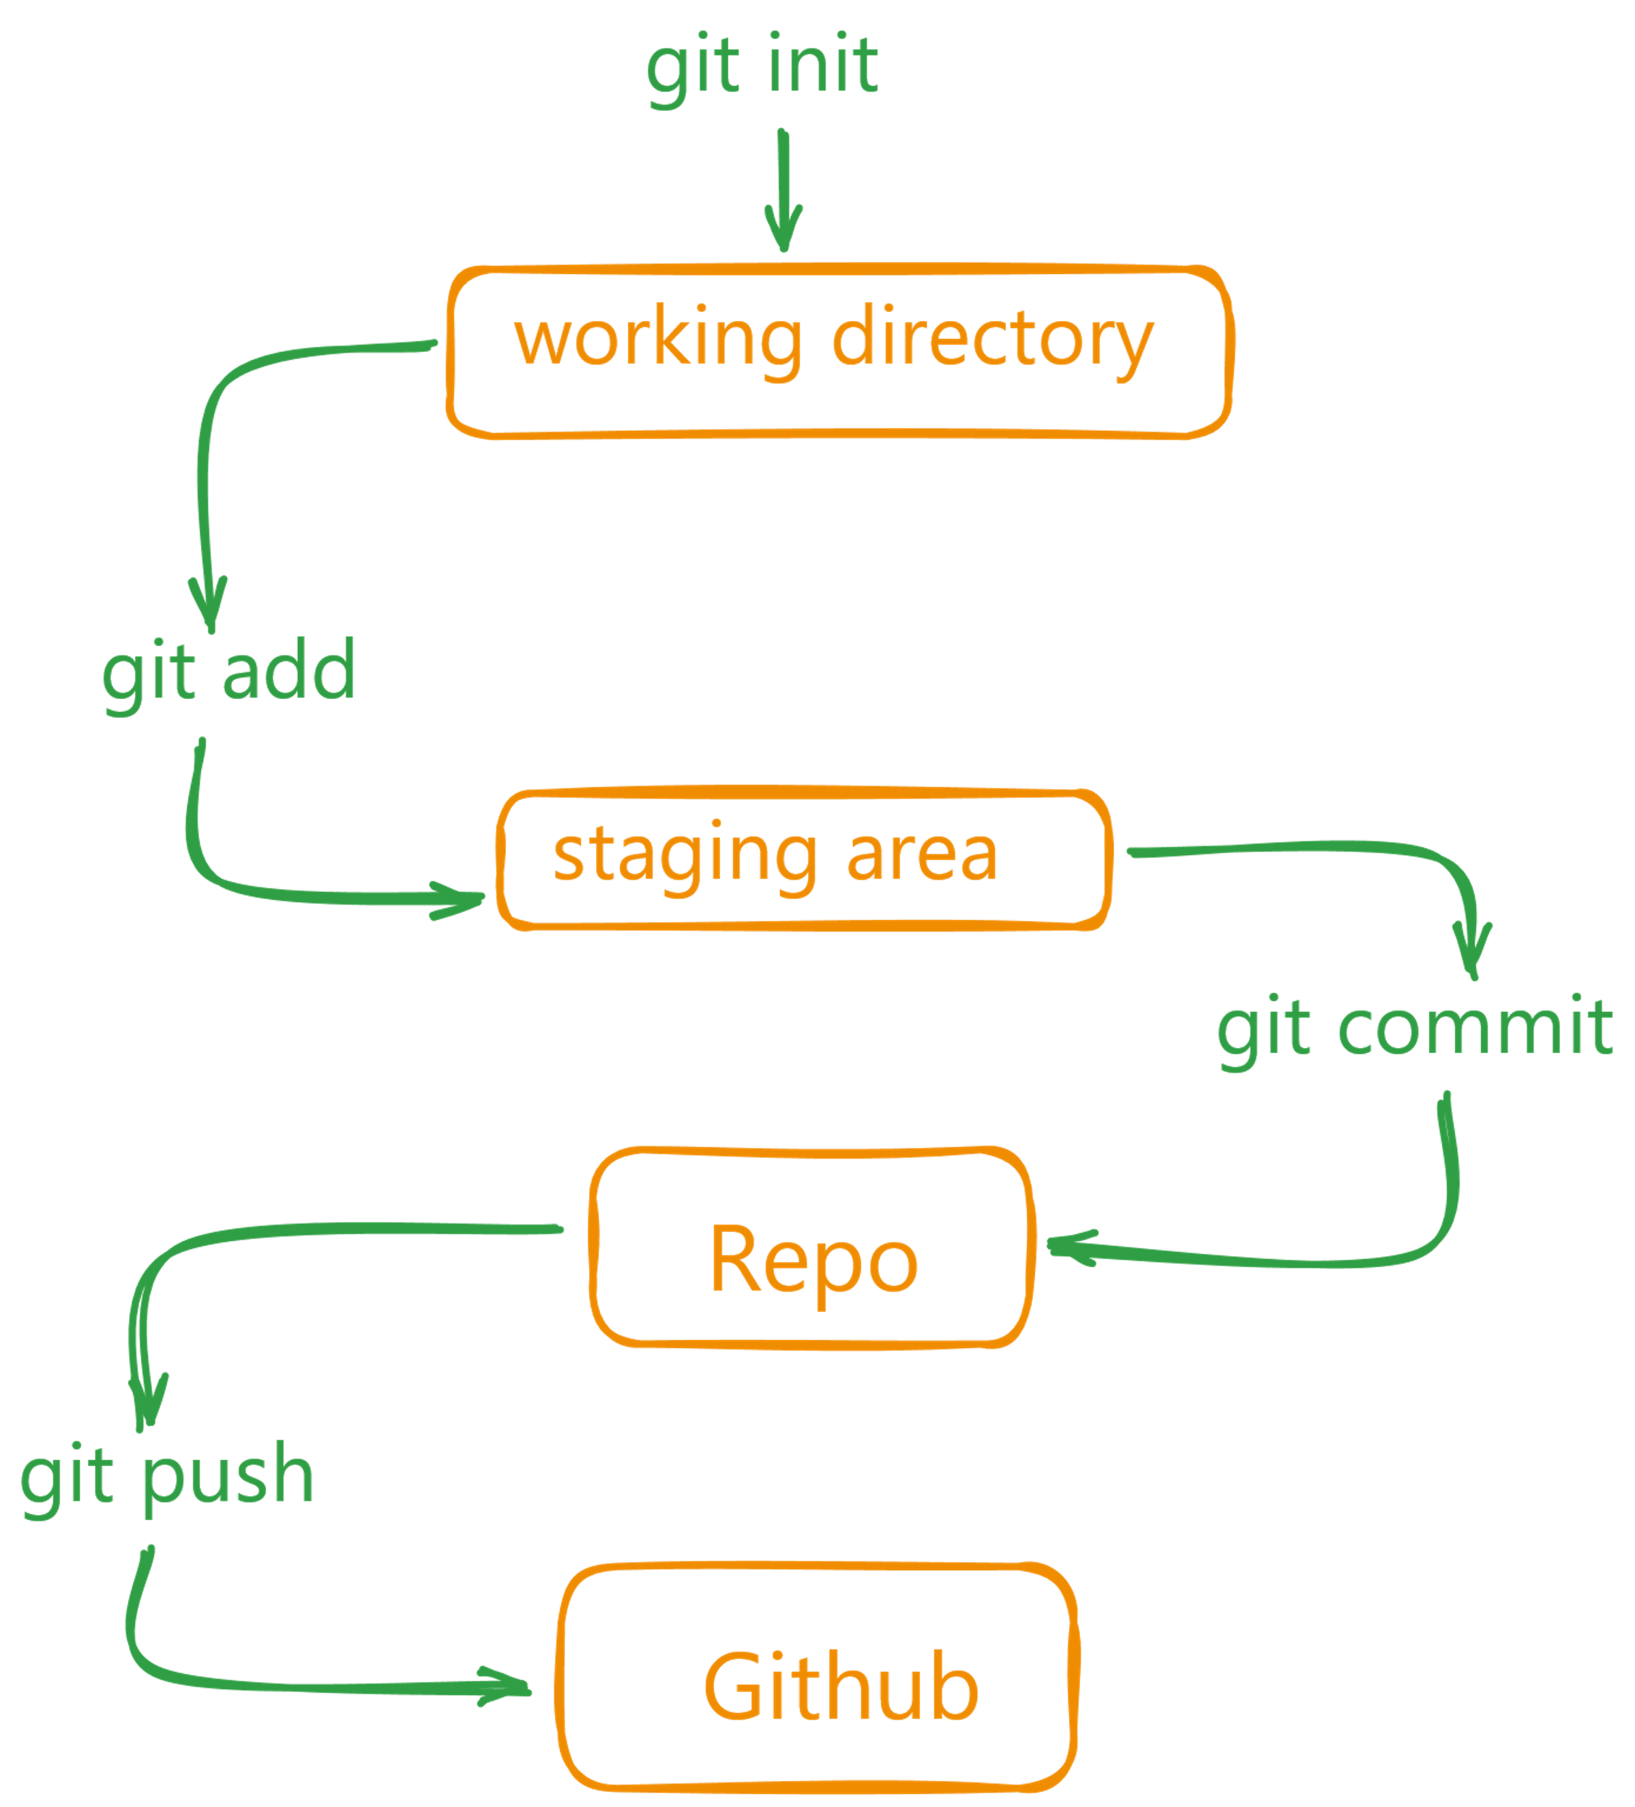
Git / GitHub Flow

Slide 14
git status
Initialize and check Repo​
create a new folder on your system and initialize it as a git repository
git init
Check current state of Repository

Slide 15
Commit
It is a way to record the changes and make them permanent.
It is like a snapshot of your code at a particular point in time.
When you commit your changes, you are telling git to save them in a permanent way.
This way, you can always go back to that point in time and see what you changed.

Slide 16
Stage
Stage is a way to tell git to track a particular file or folder.
You can use the following command to stage a file:
git add <file/folder> # To add a single file or a folder at a time
git add . # To add all files at a time
Task:
Add a single file
Add a folder
Add all the created file/ folder at a single time
Did you initialize git ?
After adding check the status of the file

Slide 17
Commit
Stage is a way to tell git to track a particular file or folder.
You can use the following command to stage a file:
git commit -m "proper commit message"
After adding check the status of the file
The -m flag is used to add a message to the commit.
This message is a short description of the file creation or change on it
Check what will happen if you miss -m

Slide 18
Logs
This command will show you the history of your repository.
It will show you all the commits that were made to the repository.
You can use the --oneline flag to show only the commit message.
This will make the output more compact and easier to read.
git log
git log --oneline
Check it out for more information about git log click here

Slide 19
Gitignore file
Gitignore is a file that tells git which files and folders to ignore.
It is a way to prevent git from tracking certain files or folders.
What type of file to add on gitignore file
.env
.vscode

Slide 20
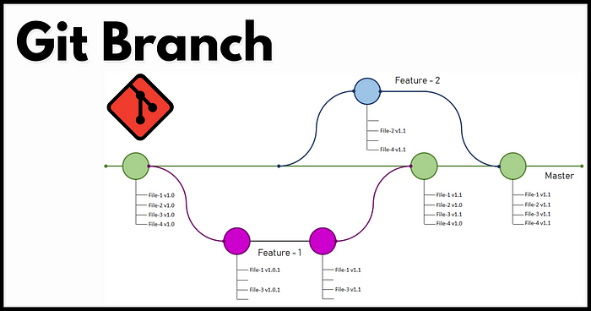
Branching in git
Branches are a way to work on different versions of a project at the same time.
This is useful when you want to make changes to a project without affecting the main code base or to add a new feature or bug fix.

Slide 21
Head in git
The HEAD is a pointer to the current branch that you are working on.
It points to the latest commit in the current branch.
When you create a new branch, it is automatically set as the HEAD of that branch.

Slide 22
Create new branch
git branch # list all the branches in the current repository
git branch "branch name" # to create a new branch give it a proper name
git switch "branch name" # to switch to the branch
git switch master/main # switch to the main/ master branch
git switch -c dark-mode # This command creates a new branch -c flag is used to create a new branch.
git checkout "branch name" #to switch to the branch
Note:
Commit before switching to a branch

Slide 23
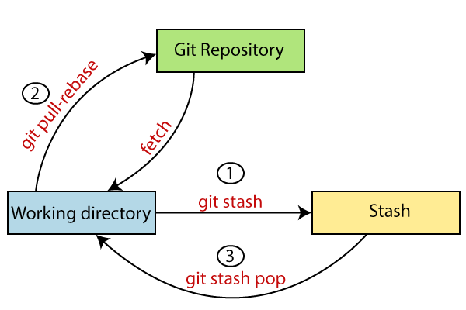
Git Stash
When to do stash and when to use commit ??

Slide 24
Try this (not necessary)
git config --global color.ui true
git gui #try it on git bash
gitk # for linux install gitk

Slide 25
Merge
git checkout main # switch to main branch
git merge "branch name" # merge the branch into main branch
This is a fast-forward merge. It means that the commits in the "branch name" branch are directly merged into the main branch.
What is merge conflict ?

Slide 26
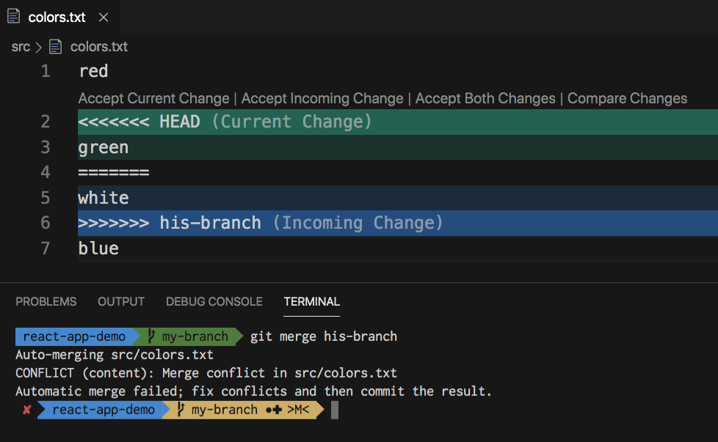
Merge
What is merge conflict ?
How to manage merge conflict ?

Slide 27
Rename Branch
git branch -m <old-branch-name> <new-branch-name>
Delete Branch
git branch -d <branch-name>

Slide 28

Need more on Git ?
Stash
Diff
Tags
Rebase
Reflog

Slide 29
GitHub
What is GitHub?
Alternatives of GitHub ?
Why GitHub ?

Slide 30
Configure git
git config --global user.email "your-email"
git config --global user.name "Your Name"
git config --list
This is for settingup git and github to store the reposotary

Slide 31
Setup SSH key
ssh-keygen -t ed25519 -C "your-email"
Add to GitHub SSH key

Slide 32
Git Clone
git clone <url>
Git Push
git push -f
git push origin main/master
git push origin –all #This command pushes all the branches to the server repository.
Git Clone
git pull <url> #It fetches and merges changes on the remote server to your working directory.
Git Remote
git remote add origin <url of repo>

Slide 33
Track Changes
git diff # Track the changes that have not been staged
git diff –staged # Track the changes that have staged but not committed
git diff HEAD # Track the changes after committing a file
git diff git diff branches
git diff <branch> #Track the changes between two commits
What will it do ?
git show

Slide 34
Ignoring files
git ls-files -i –exclude-standard
Git Log
git log # Display the most recent commits and the status of the head git log –oneline # Display the output as one commit per line git log –stat # Displays the files that have been modified git log -p # Display the modified files with location

Slide 35
Git fetch
Download branches and tags from one or more repositories. Fetch the remote repository:
git fetch< repository Url> #Fetch a specific branch
git fetch
Fetch all the branches simultaneously git fetch –all
Synchronize the local repository git fetch origin

Slide 36
Git Undo changes
Undo the changes: git revert Revert a particular commit: git revert
Reset the changes: git reset -hard git reset -soft git reset --mixed
Remove the files from the working tree and from the index: git rm <file Name> Remove files from the Git But keep the files in your local repository: git rm --cached

Slide 37
Tags
Create Tag
git tag <tag-name>
git tag -a <tag-name> -m "Release 1.0"
List Tag
git tag
Tagging a specific commit
git tag <tag-name> <commit-hash>
Push tags to remote repository
git push origin <tag-name>

Slide 38
Tags
Delete a tag
git tag -d <tag-name>
Delete tag on remote repository
git push origin :<tag-name>
TASK:
rebase
reflog

Slide 39

Thank you

